Slide 1

Concussion and Traumatic Brain Injury Among Native Americans in Arizona
Joshua Drywater
Austin Duncan, PhD
Sonoran Center for Excellence in Disabilities
University of Arizona
Panelists: Nekesia Tulley, Kenny Dodson, Tona TreeTop
June 14, 2023
Notes:
Funding was made possible in part by the Arizona Governor's Council on Spinal and Head Injuries.
Learn more about the Council and its work at https://headspineaz.org

Slide 2
Introduction
Concussion and Traumatic Brain Injury (TBI) = Head/Brain Injury
Outline:
      Incidence among Native Americans in Arizona
      Life “with TBI” is primarily a social (not medical) issue
      Survivors and Family Panel
      Q&A and Audience Discussion

Slide 3
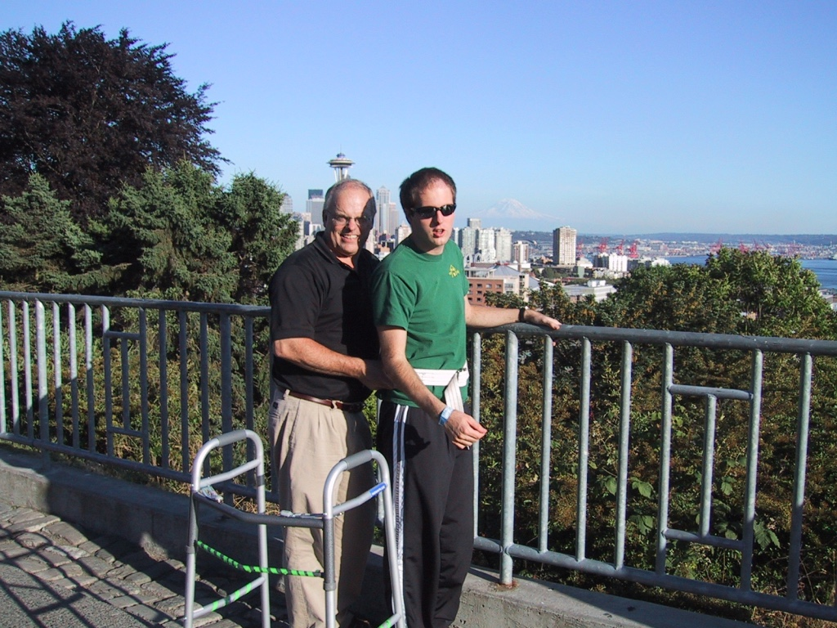
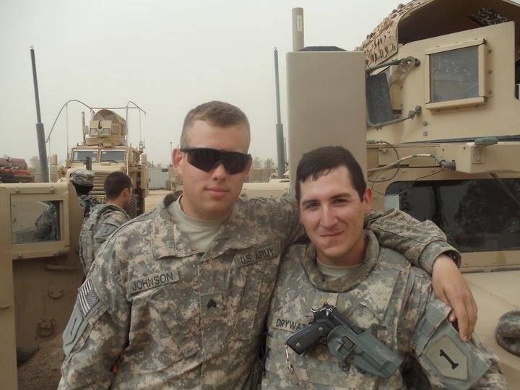
Self-disclosures

Slide 4
Concussion and TBI
Definition: Disruption in the normal function of the brain caused by a bump, blow, or jolt to the head, or a penetrating head injury
Over 2 million in the U.S. every year
Numerous causes (falls, assaults, struck by/against, traffic accidents, etc.)
Severities of injury varies (Concussion, moderate, severe)
Sequelae (consequences of injury) vary between survivors and over time
Native Americans have the highest recorded incidence
(Source: CDC)

Slide 5
Concussion & TBI among Native Americans
We don’t know the true incidence, but we have some statistics
Natives Americans have the highest rates of hospitalization and death
189.6 hospitalizations and 43.7 deaths per 100,000 in AZ in 2020
Top Causes: Falls, Assault, Accident
Native American survivors risk poor outcomes due to disparities: health, poverty, violence, systemic racism
(Sources: NIH, ITCA)

Slide 6
Concussion and TBI after Medical Care
Sequelae vary by survivor
Context matters
There is NO universal sequela
Sequelae improve and regress throughout survivors’ lives
Survivors’ experiences change throughout the day/week/year
Environmental (climate, physical accommodations, sensory, etc.)
Social (interaction, social support and accommodations, tolerance/misunderstanding)
Take-home: Survivors may not have anything in common
So how can we help them?

Slide 7
Social Life and Concussion/TBI
Sequelae appear in some contexts/interactions/times but not others
Survivors often have trouble (re)building their social lives
Misunderstandings are frequent…
→leading to stigmatization…
→which interacts with other factors (gender, age, class, etc.)…
→which drives survivors into social isolation, poverty, homelessness, even suicide
Families and Communities can mitigate these harmful outcomes

Slide 8
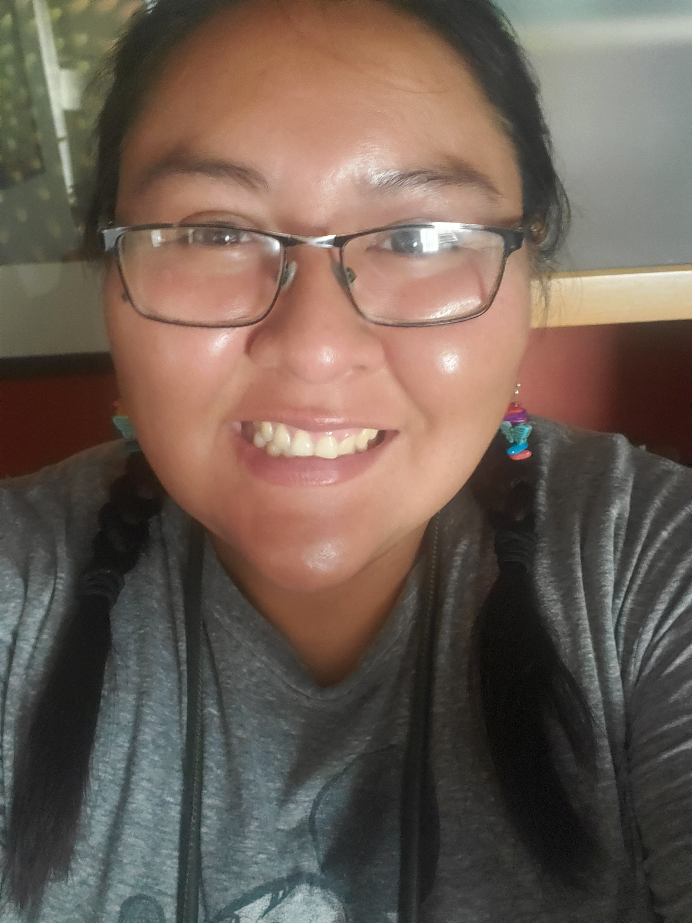
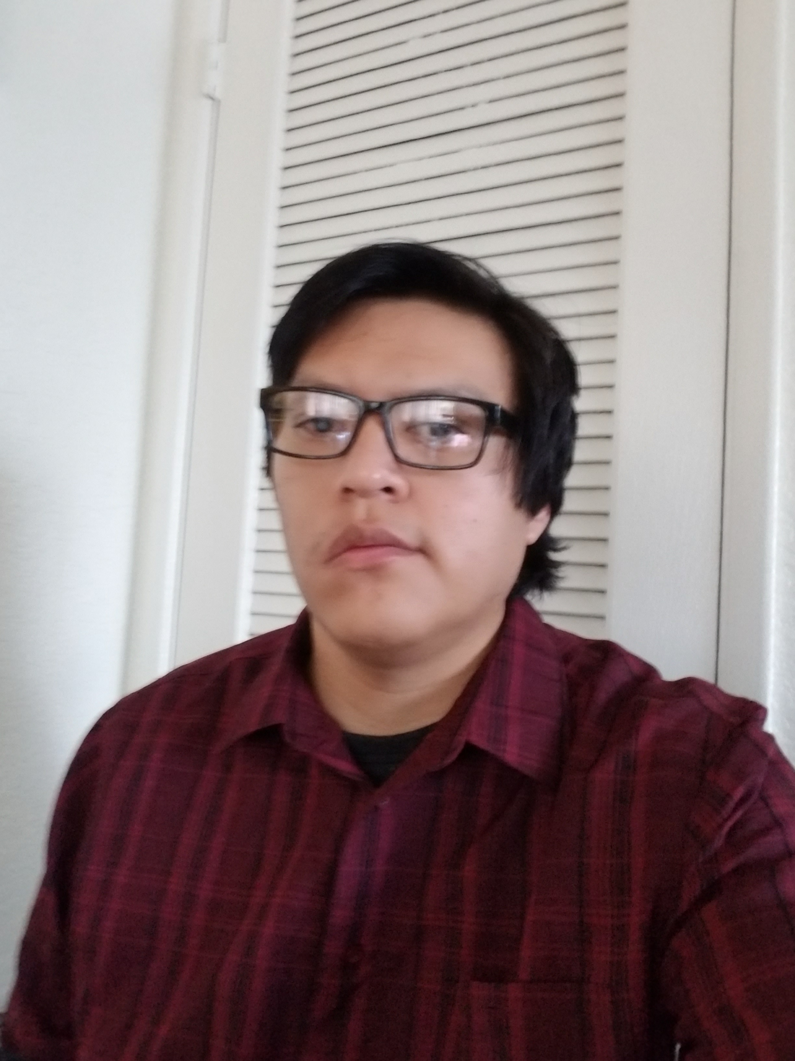
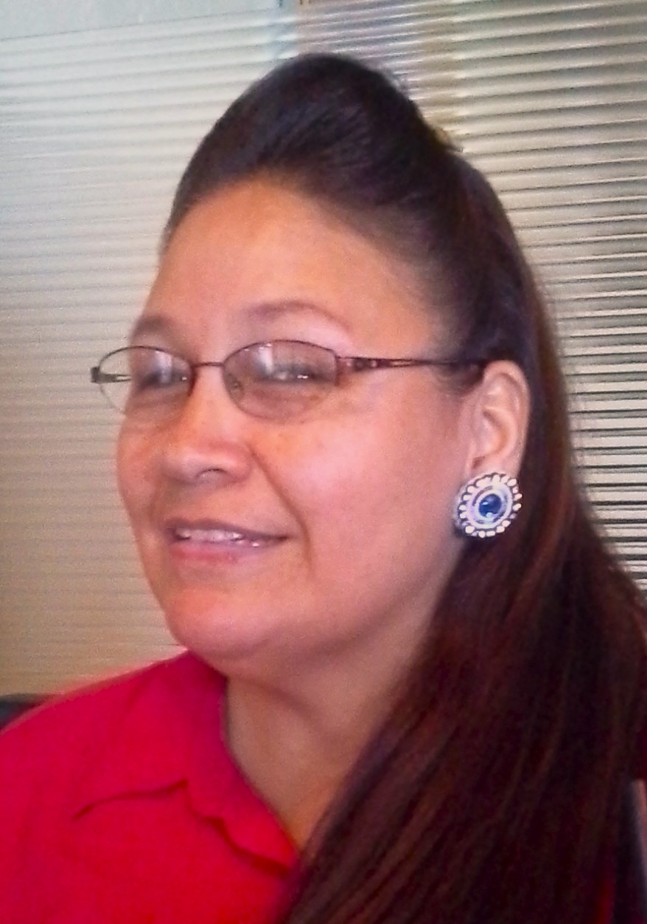
Survivor & Family Panel
Nekesia Tulley
Kenny Dodson
Tona TreeTop

Slide 9
We want to hear from you!
1 – What is available to support Concussion/TBI survivors in your communities ?
2 – What more is needed?
The Inter Tribal Council of Arizona’s TBI preventive recommendations (https://itcaonline.com/wp-content/uploads/2020/02/ITCA_AZ_TBI_Fact-Sheet_draft_1.1.pdf)

Slide 10
Important Resources
TBI Resource Bundle for American Indians
https://www.air.org/project/traumatic-brain-injury-resource-bundle-american-indians
Inter-Tribal Council of Arizona report on TBI among American Indians in Arizona, Nevada, and Utah
https://itcaonline.com/wp-content/uploads/2018/10/TBI-Report_FINAL-v2-10.19.18.pdf
AZ Governor’s Council on Spinal and Head Injuries (Spinal Cord Injury, Childhood Brain Injury, TBI, and Concussion)
https://headspineaz.org/
Brain Injury Alliance of Arizona (information and resources on all types of brain injuries for survivors & family)
Special focus on COVID-19 & the Brain (https://biaaz.org/covid-and-the-brain/)
Brain Injury & Substance Use Disorder (https://biaaz.org/opioid-sud/)
How to Get Help (https://biaaz.org/get-help/)
TBI FactSheet (https://goyff.az.gov/sites/default/files/meeting-documents/materials/az_tbi_stats_d4.pdf)
“The Noggin”, a TBI magazine (https://biaaz.org/the-noggin/)
Brain Injury Support Groups in AZ (https://brainandspinalcord.org):
https://www.brainandspinalcord.org/support-groups-brain-injury-arizona/
ADE Traumatic Brain Injury information: https://www.azed.gov/specialeducation/tbi

Slide 11
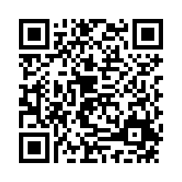
Thank you!
We value your feedback!
Join us for this month’s Native Center on Disabilities Webinar
      A Journey of Brain Injury from Indigenous &
      Rural Perspective
      Friday, June 30, 2023, 11:00am MST/PDT
      Maria Martinez and Regina Sisneros, Colorado
      Resources and Practical lessons covered

